Slide 1
CNCF Serverless WG
CloudEvents and Serverless Workflow
Doug Davis, IBM
Tihomir Surdilovic, Red Hat

Slide 2
Agenda
•Serverless WG / CloudEvents Update
•Workflow Specification Intro & Update

Slide 3
Agenda
•Serverless WG / CloudEvents Update
•Workflow Specification Intro & Update

Slide 4

CloudEvents - Status
Status & Deliverables
CloudEvents specification v1.0
Transport Bindings ( HTTP, AMQP, MQTT, NATS, Kafka)
Encoding Formats ( JSON, AVRO )
Primer
SDKs ( CSharp, Go, Java, Javascript, PHP, Python, Ruby, Rust )
What's next?
Customer feedback...
Additional community pain points...

Slide 5
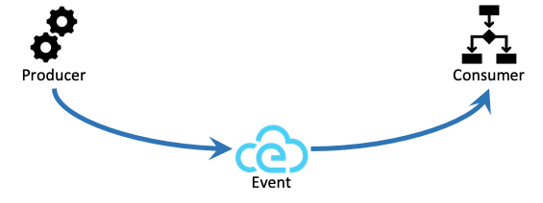
CloudEvents - Status
Delivery of CloudEvents is the last step

Slide 6
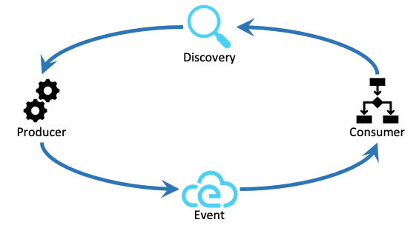
CloudEvents - Status
Delivery of CloudEvents is the last step
Discovery API Spec
Who produces the events of interest?
Which events are produced?
What subscription options are available?
How to subscribe?

Slide 7
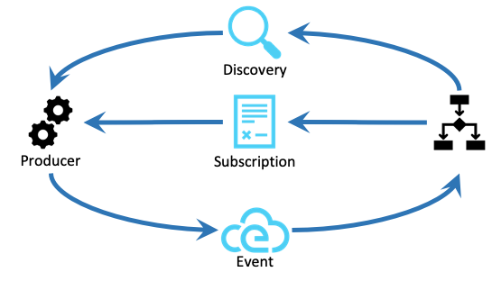
CloudEvents - Status
Delivery of CloudEvents is the last step
Discovery API Spec
Who produces the events of interest?
Which events are produced?
What subscription options are available?
How to subscribe?
Subscription API Spec
Which events to deliver?
How/where to deliver the events?
Format of the messages?
How to manage the subscription?

Slide 8
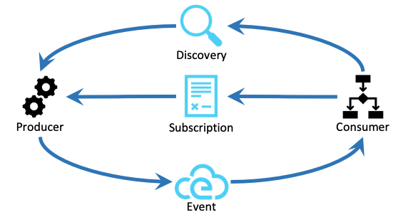
CloudEvents - Status
Delivery of CloudEvents is the last step
Discovery API Spec
Who produces the events of interest?
Which events are produced?
What subscription options are available?
How to subscribe?
Subscription API Spec
Which events to deliver?
How/where to deliver the events?
Format of the messages?
How to manage the subscription?
Delivery - CloudEvents Spec
Push vs Pull
Transport
Format

Slide 9
Agenda
•Serverless WG / CloudEvents Update
•Workflow Specification Intro & Update

Slide 10
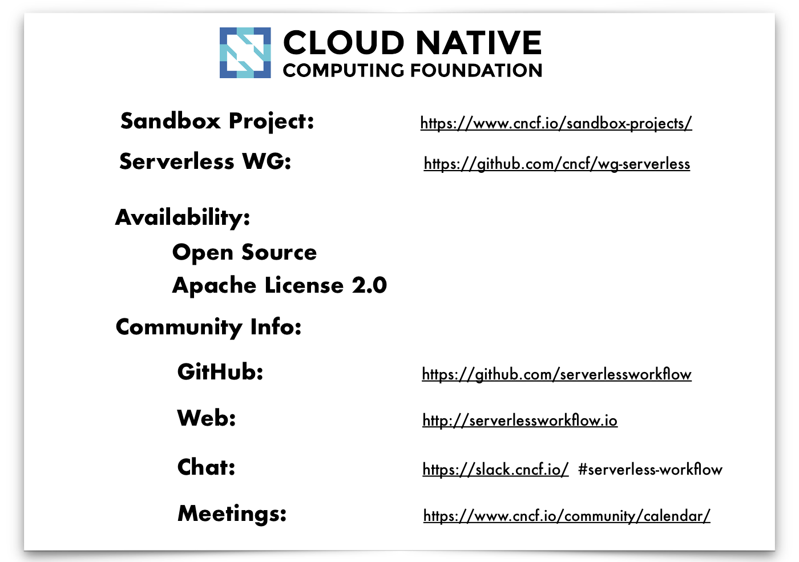

Serverless Workflow

Slide 11
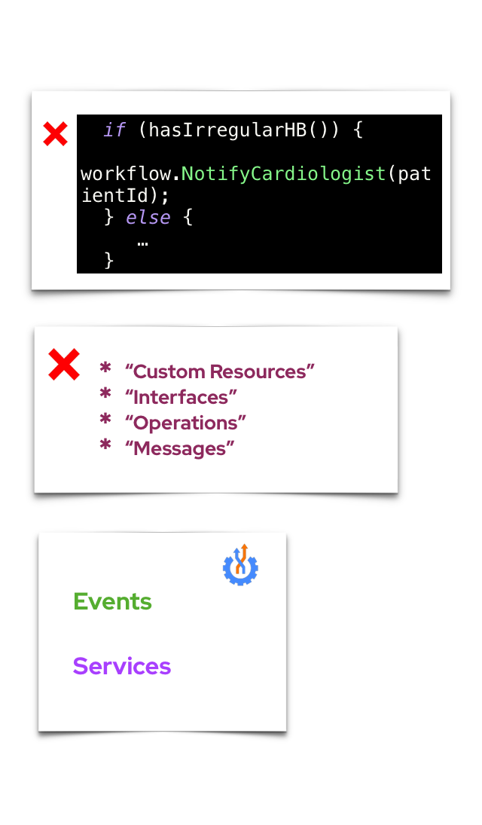
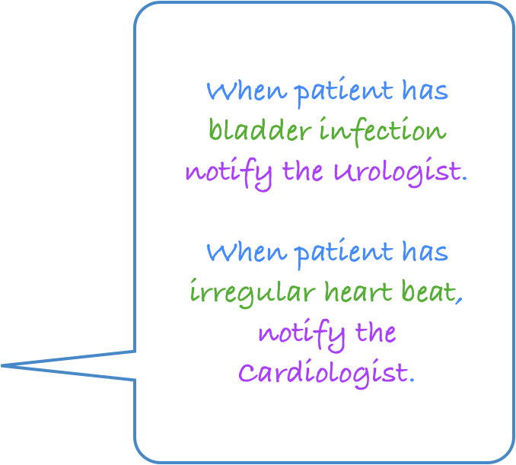


Serverless Workflow
Declarative, domain-specific workflow language
(Orchestration of event-driven, distributed services)

Slide 12
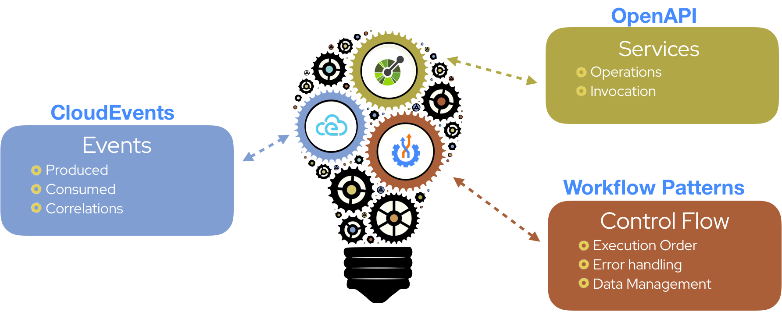
Serverless Workflow
Based on standards

Slide 13
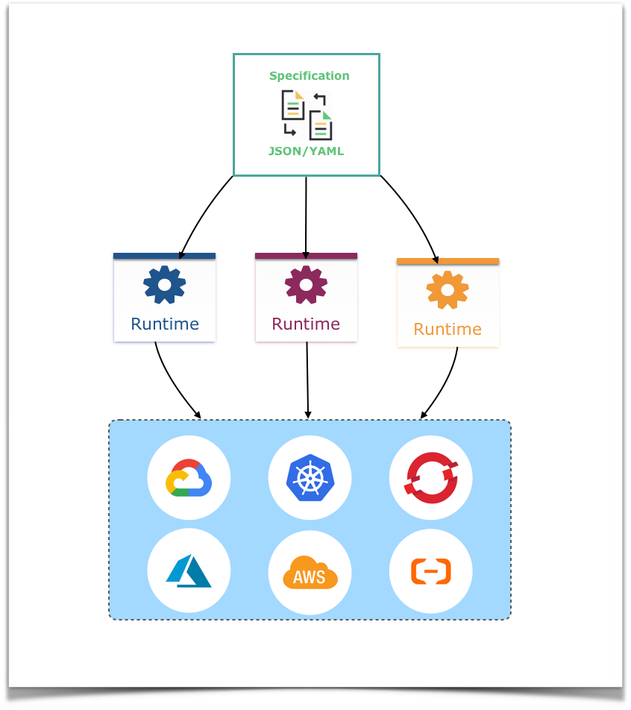
Serverless Workflow
Project Goals
Portable
Vendor-neutral

Slide 14
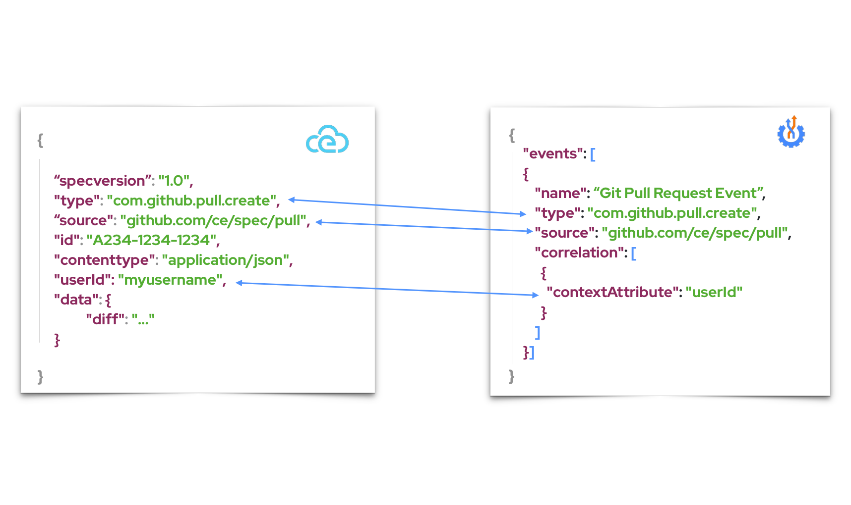
Serverless Workflow
Event Definitions
“Define events that are consumed or produced
during workflow execution.”

Slide 15
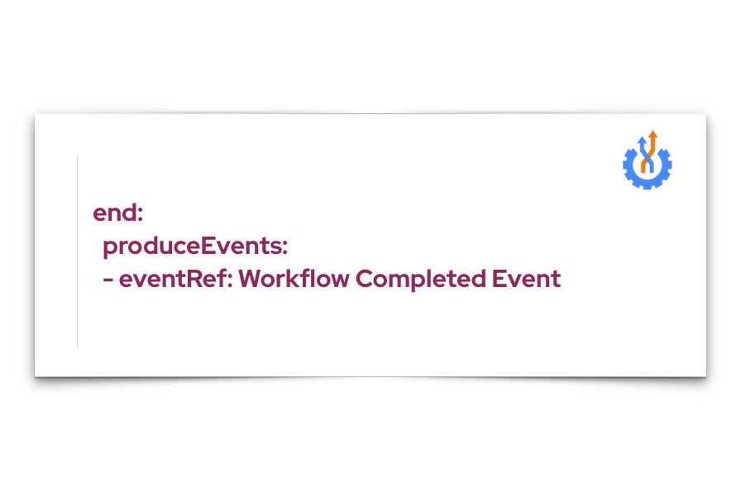
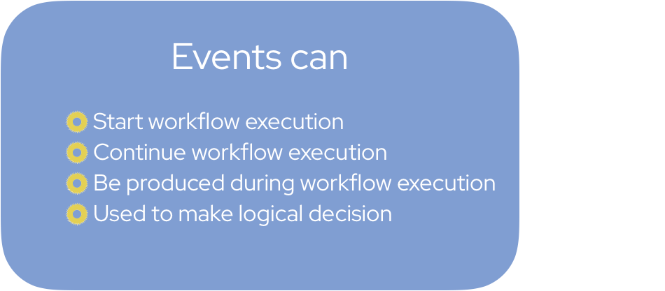
Serverless Workflow
Interactions with Events
Produce event example

Slide 16
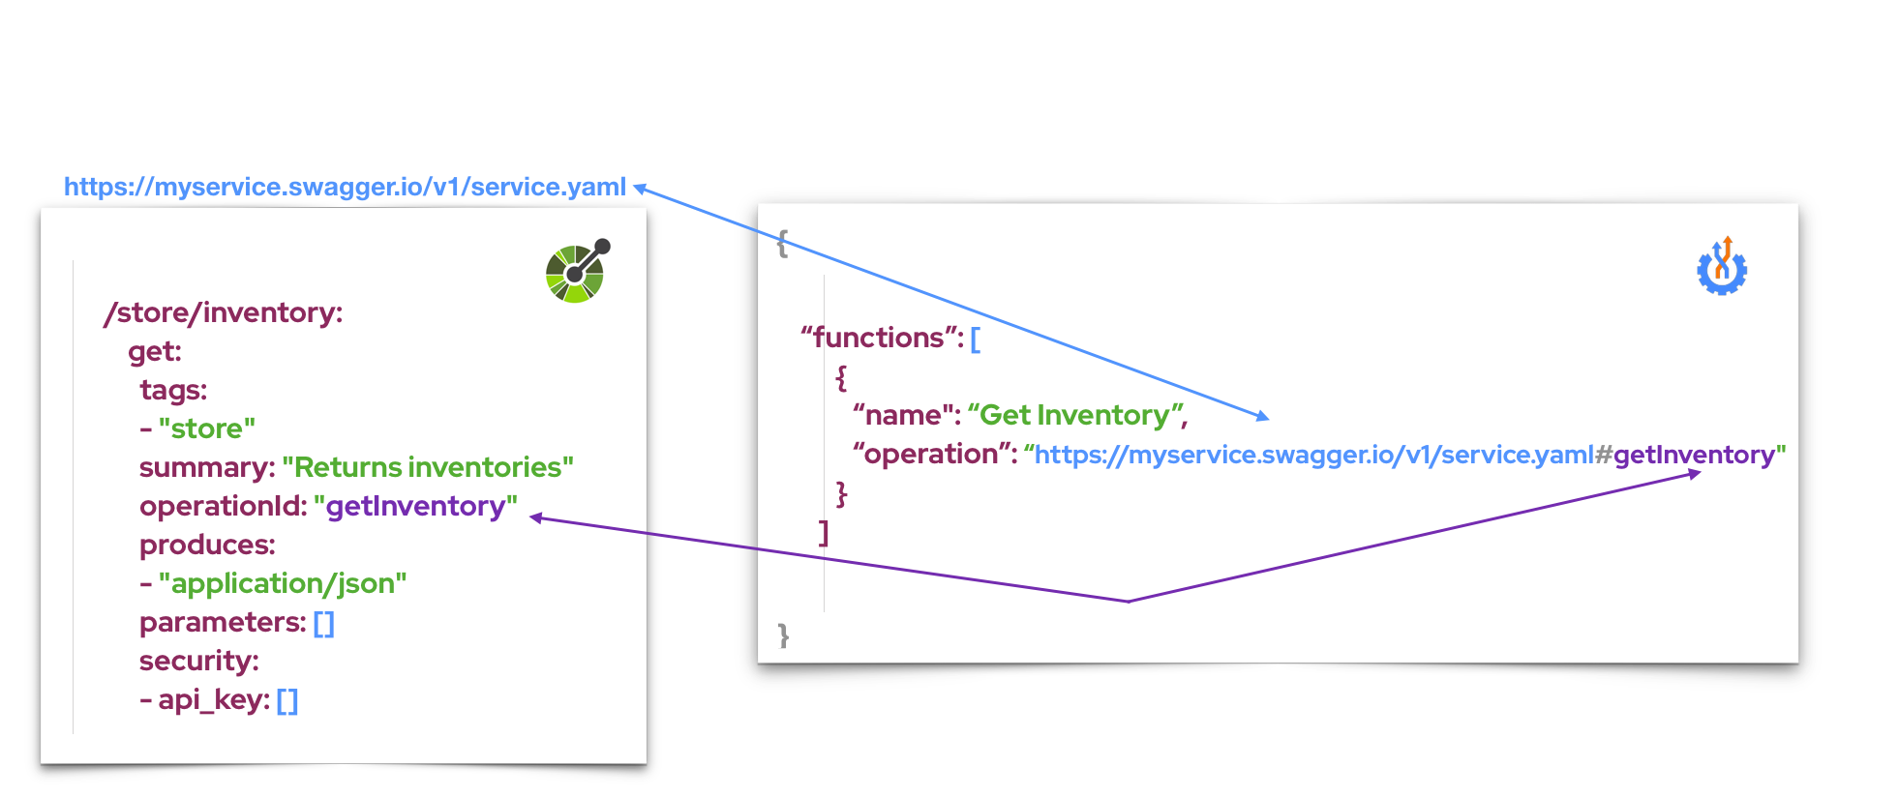
Serverless Workflow
Function Definitions
“Define service operations that need to be
invoked during workflow execution”

Slide 17
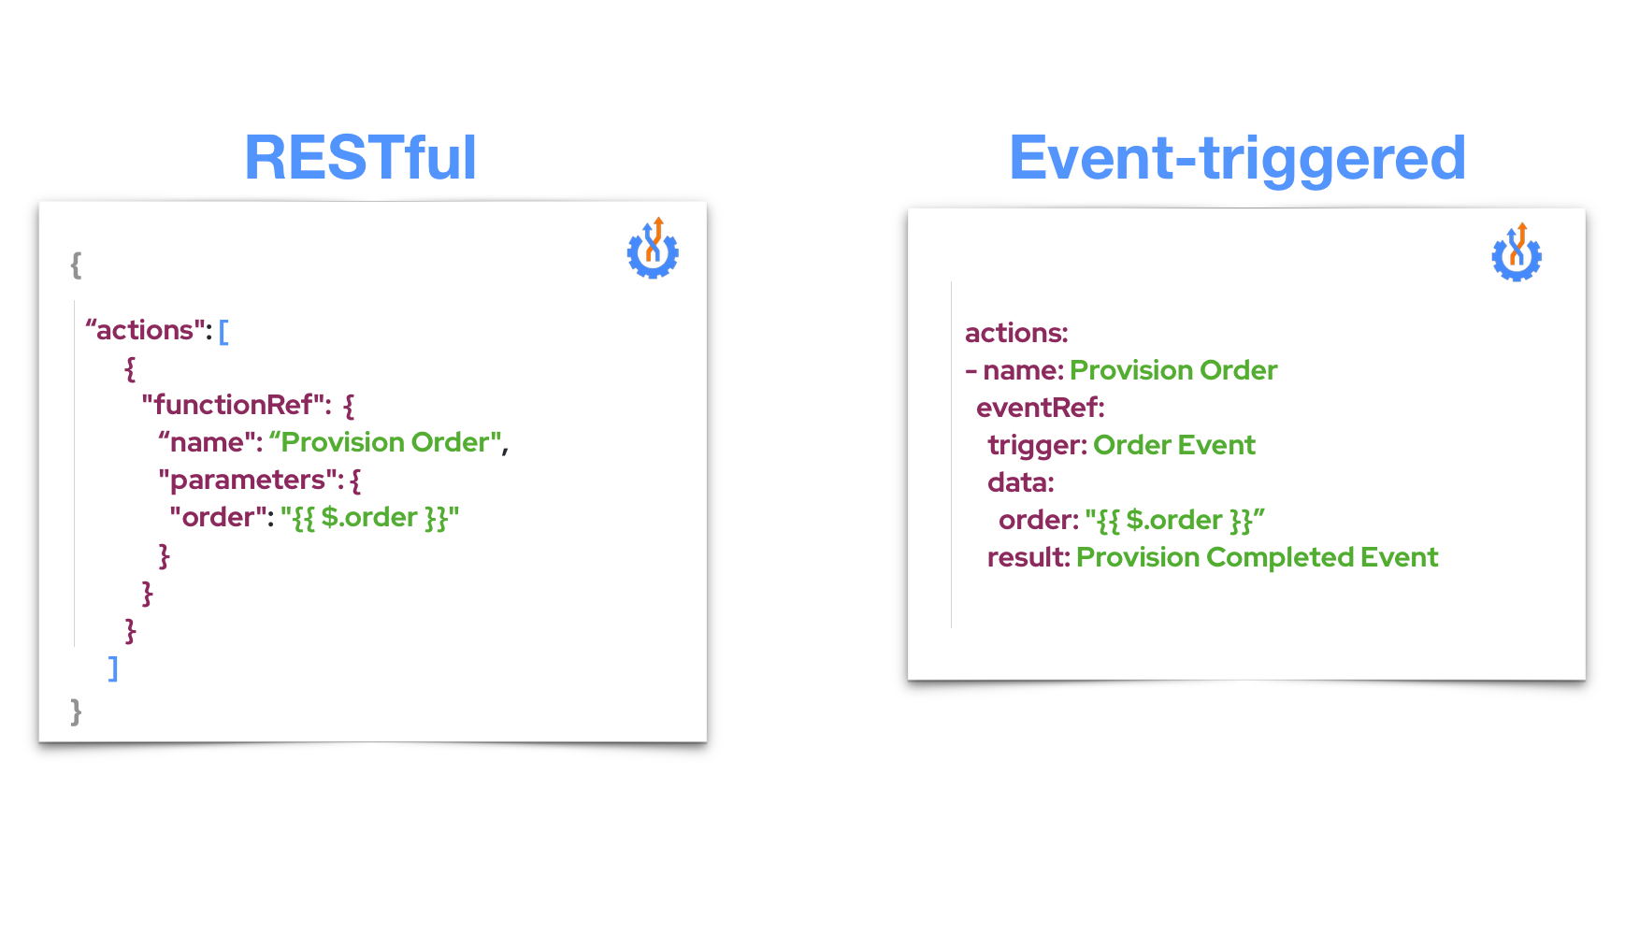


Serverless Workflow
Invoking Services

Slide 18
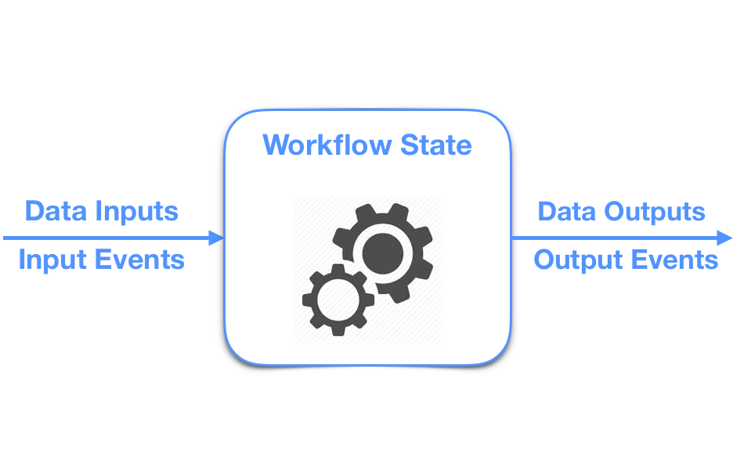
Serverless Workflow
Control Flow Logic
“Define workflow states and
the order in which they are executed”

Slide 19
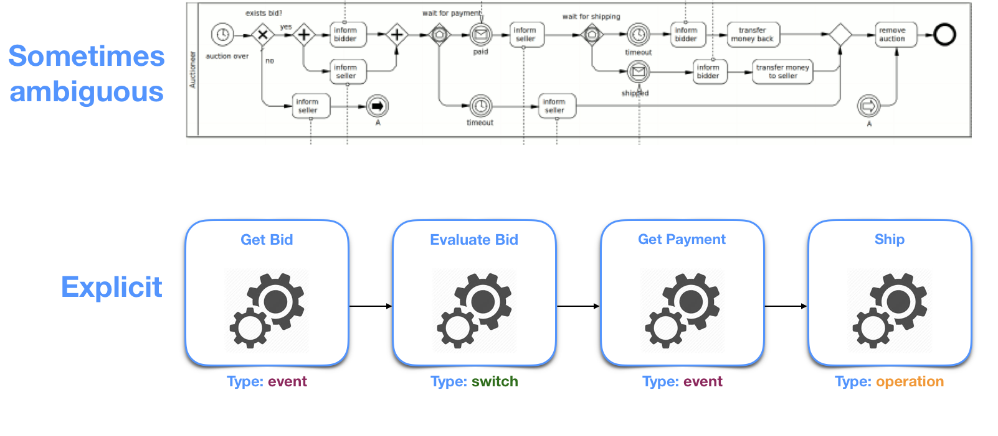
Serverless Workflow
Explicit Control Flow
“Clearly define what you are building”

Slide 20
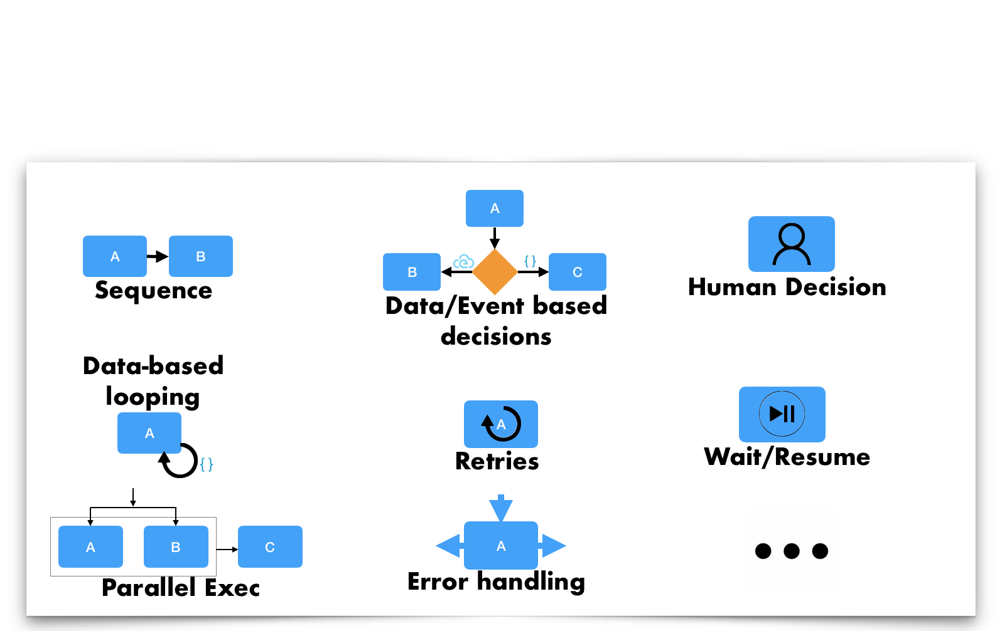
Serverless Workflow
Control Flow Patterns

Slide 21
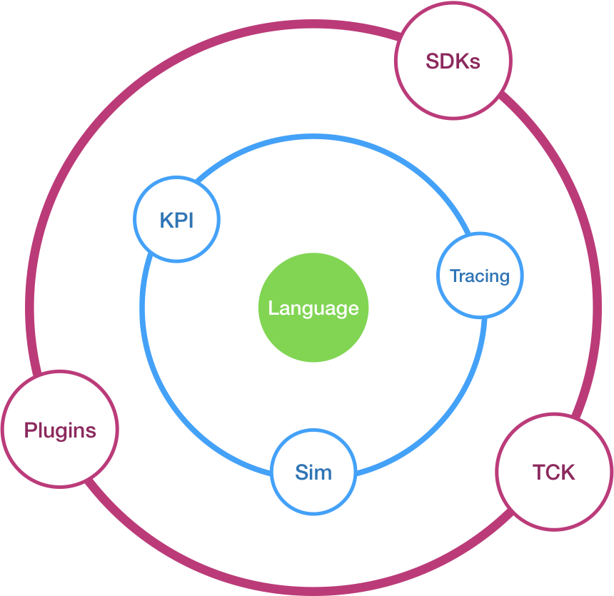
Serverless Workflow
Project Components

Slide 22
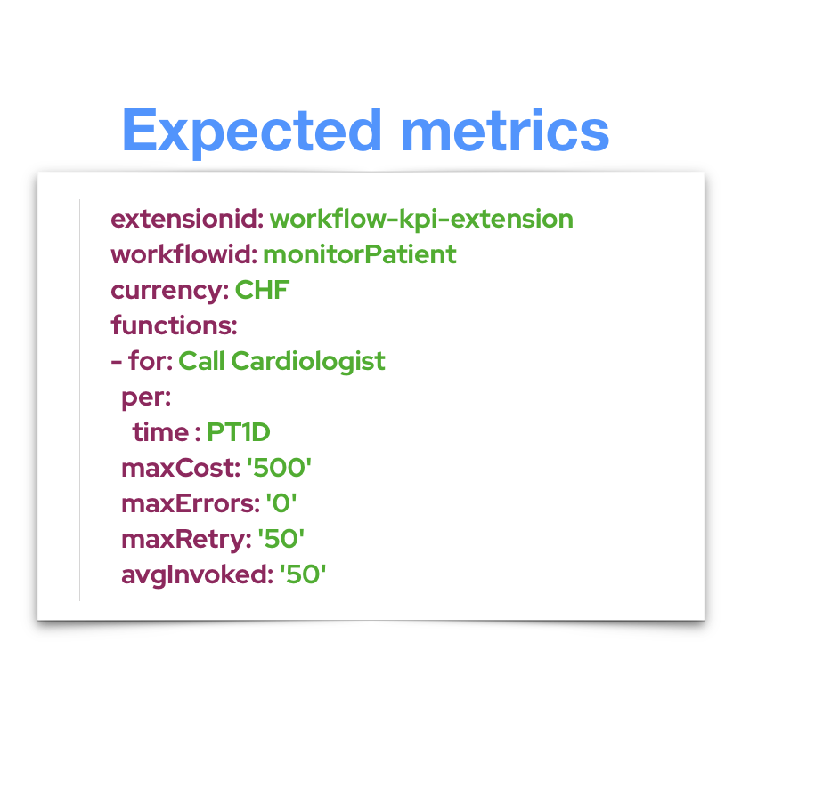
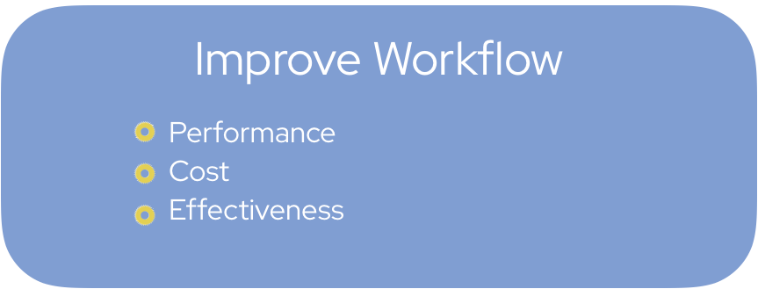
Serverless Workflow
Quick peek - Workflow KPI Extension
“Compare expected vs. actual data”

Slide 23
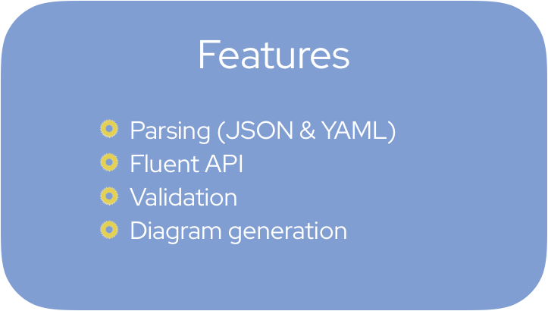
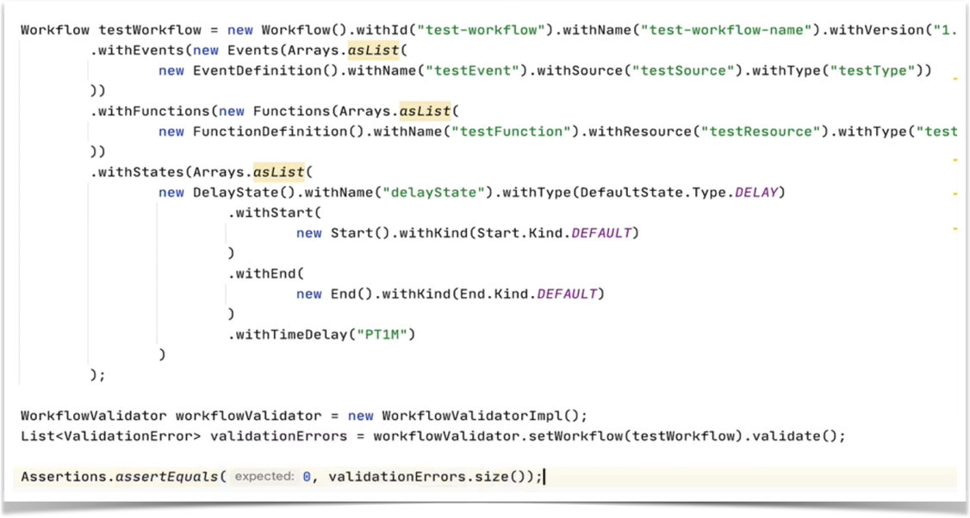
Serverless Workflow
Quick peek - JAVA SDK

Slide 24
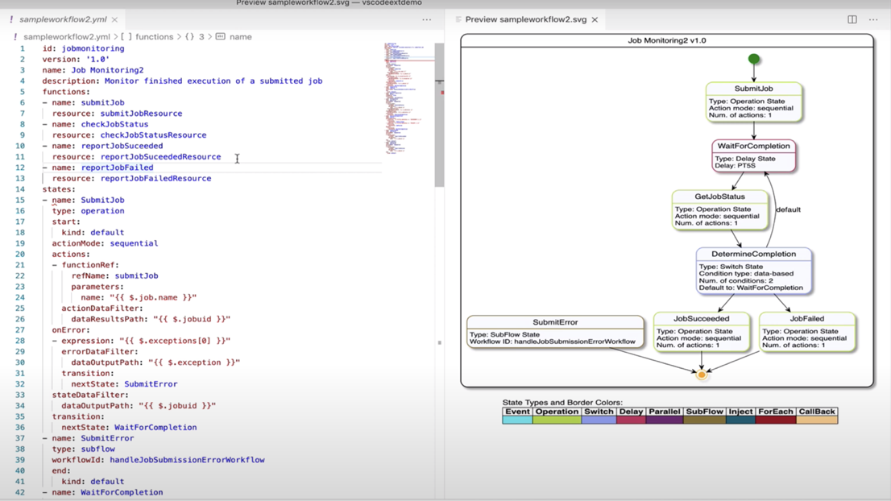
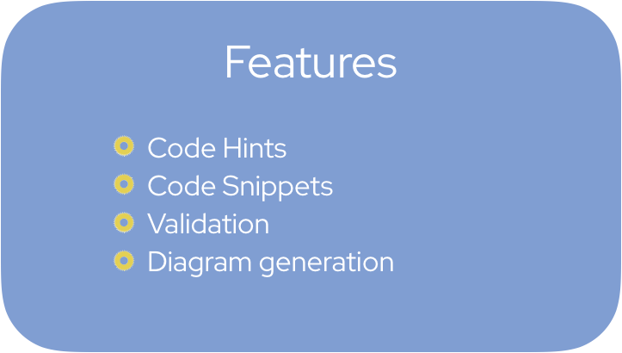
Serverless Workflow
Quick peek - VSCode Plugin

Slide 25
Serverless Workflow
Demo

Slide 26
Q&A - Thank You!
More information
CloudEvents: https://cloudevents.io
Specifications repo: https://github.com/cloudevents/spec
Weekly calls - Thursdays at 12pm ET (see repo for dial-in info and slack coordinates)
Serverless Workflow: https://serverlessworkflow.io
Specifications repo: https://github.com/serverlessworkflow/specification
Biweekly meetings, every second Monday at 1PM ET (see repo for dial-in info and slack coordinates)
Need more?
Doug Davis - dug at us.ibm.com
Tihomir Surdilovic - tsurdilo at redhat .com

